Slide 1
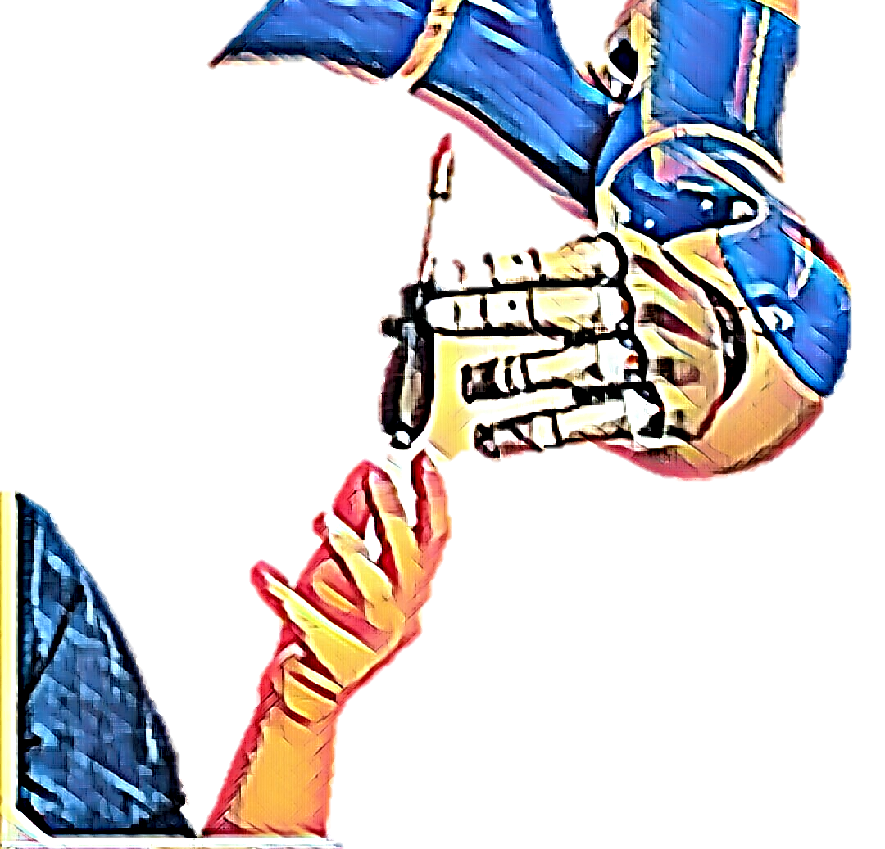
Learning Interaction Primitives from Demonstration for Future Industrial Applications
Guilherme Maeda
Jan Peters
TU Darmstadt
Intelligent Autonomous Systems

Slide 2
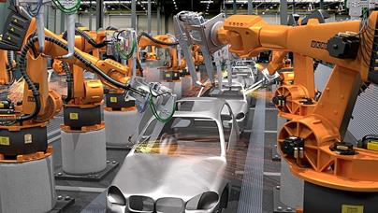
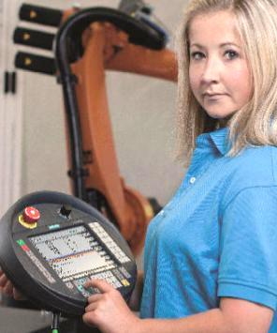
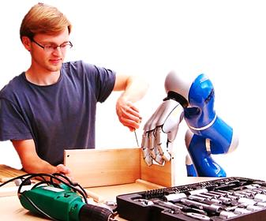
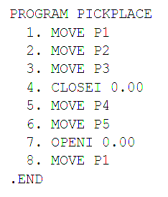
The problem:
Programming collaborative robots
Today
Tomorrow
[1]
$$$
No humans allowed
Large factories
Human-centred production
Small, medium sized factories
[1] http://www.toolingandproduction.com/cms/tap/opens/articleview.php?nid=3&bid=285&aid=1225&eid=Website%20Visitor&lk=1&sr=R&tp=Y

Slide 3
Our approach: Interaction Primitives
Multiple demonstrations
Agent 1
Agent 2
Trajectory
Trajectory
Agent 1
Agent 2
Collaboration

Slide 4
Our approach: Interaction Primitives
Probabilistic modeling
Agent 1
Agent 2
Trajectory
Trajectory
Interaction Model
[Maeda, et al., AURO, 2016]

Slide 5
Our approach: Interaction Primitives
Query and inference
What the human is doing
Agent 2
What the robot should do
Agent 1
Trajectory
Trajectory
Observations
“high-five”
Interaction Model
IN

Slide 6
Example with Multiple Interaction Primitives
10X

Slide 7
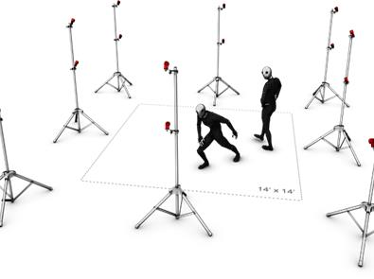
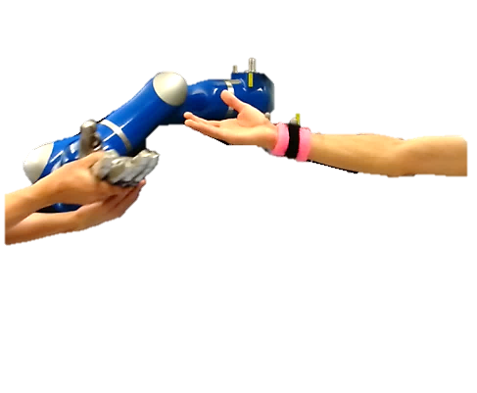
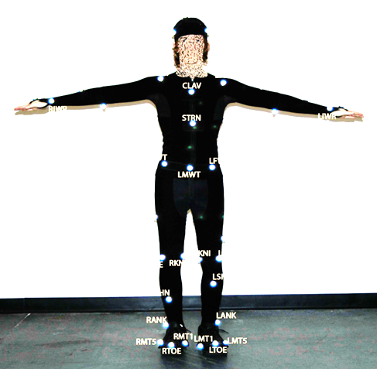
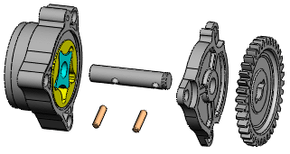
Moving One Step Forward
Problem 1
How to learn from data in a real industrial scenario?
Robots cannot be too dependent on human decisions
Robots that lead task may undervalue/frustrate the human
…
Disrupt the work
Disrupt the environment
Disrupt mobility
Problem 2
What is the right level of autonomy and how to adapt it?
Autonomy
Safety
Baby sitting
Efficiency
Error prone

